Slide 1
Tutorial on Zero Velocity Update
Yan Wang
(wangyanphyllis@gmail.com)

Slide 2
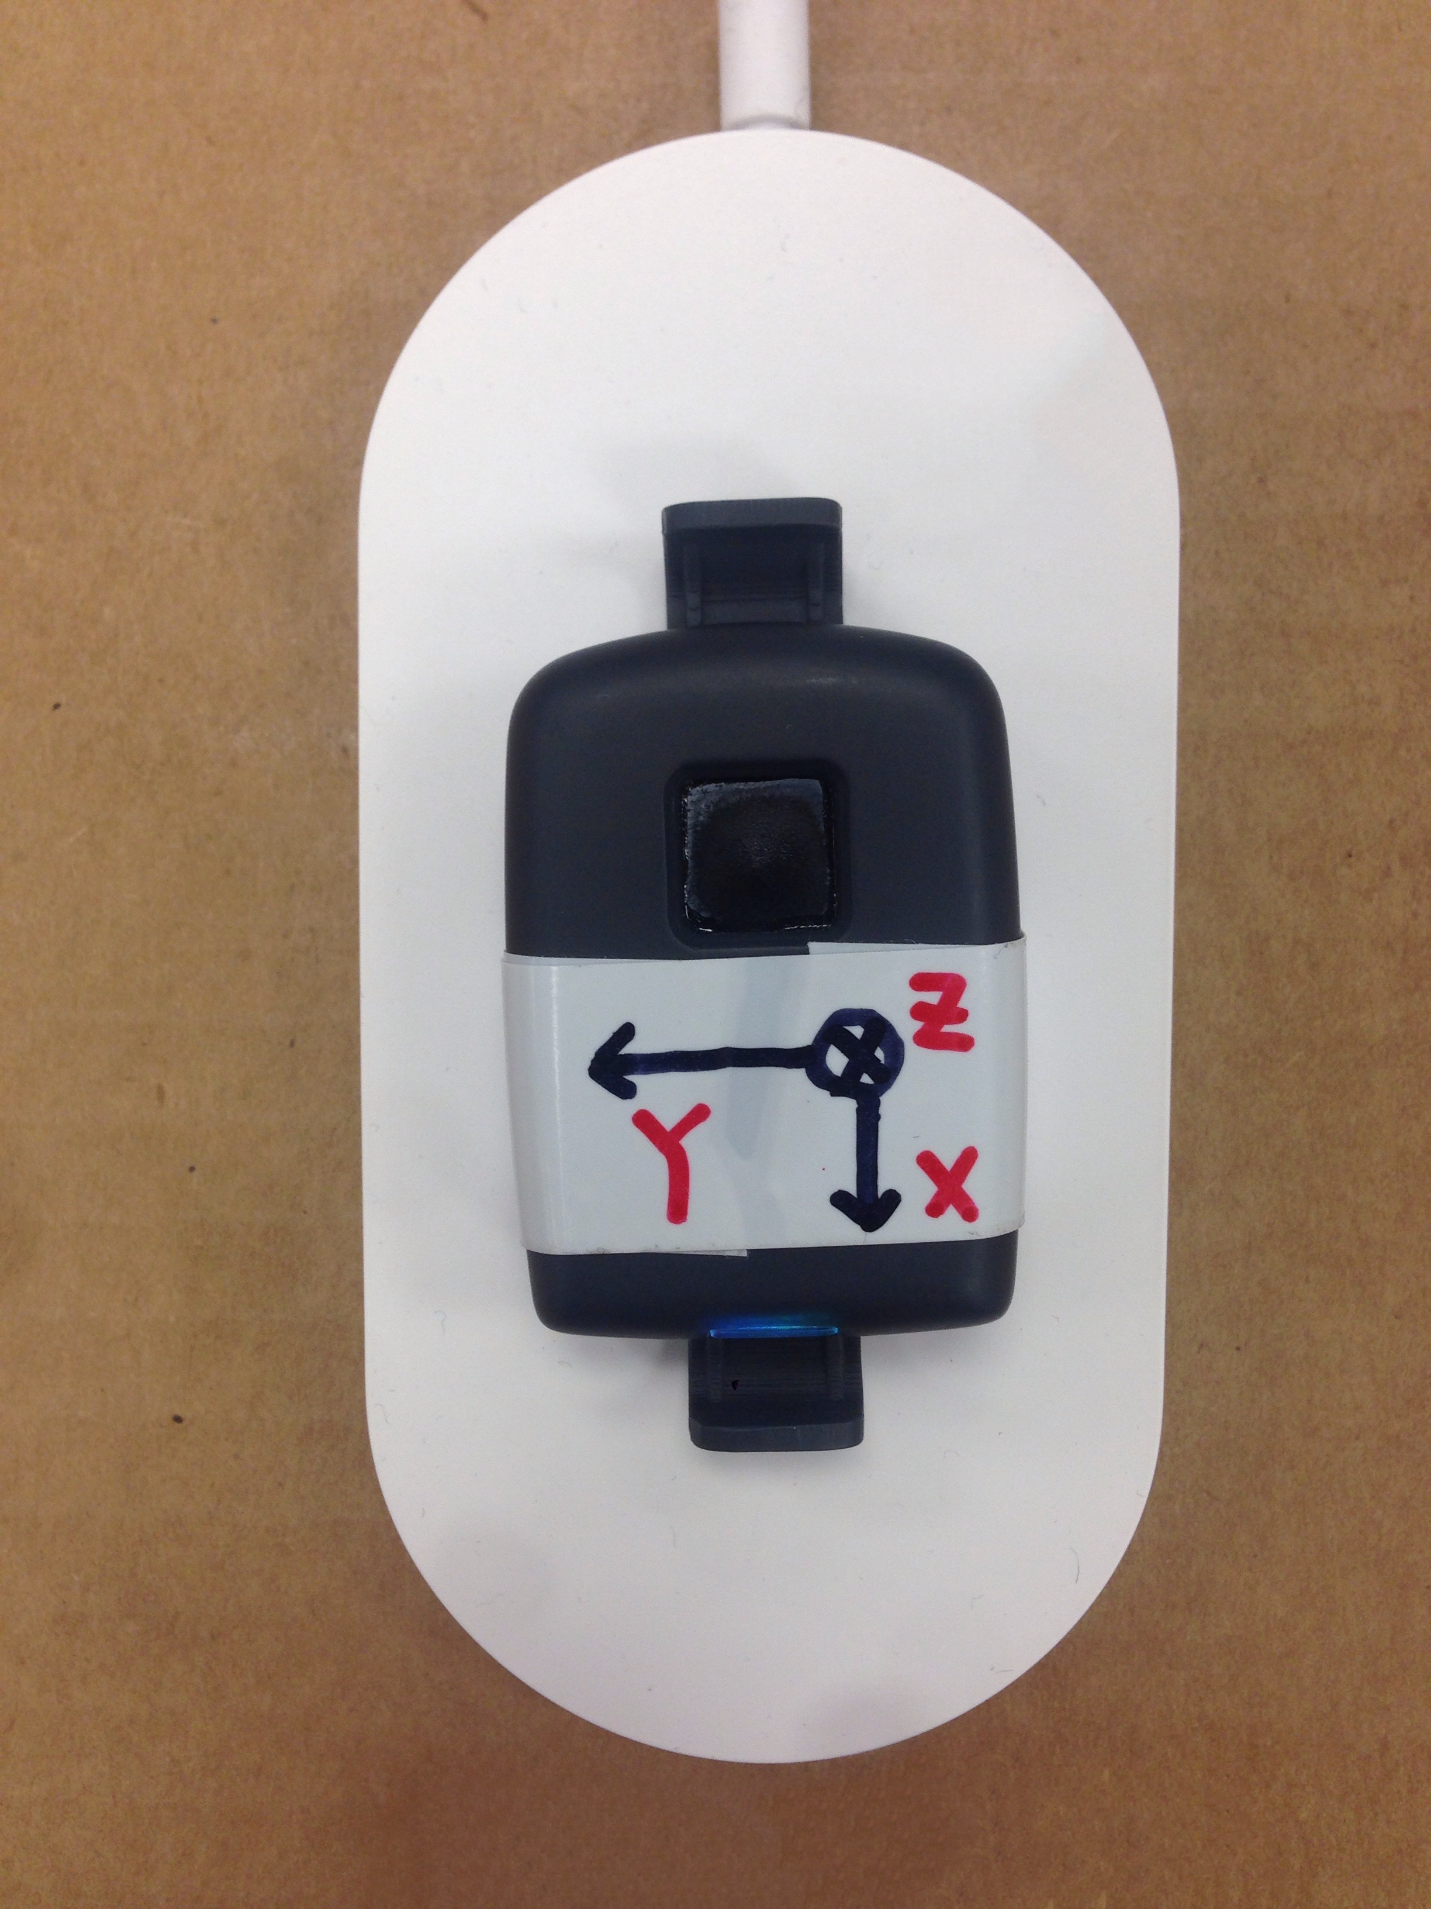
1. Inertial Navigation Algorithm
6DOF Inertial Sensor: Accelerometer + Gyroscope

Slide 3
2. Limitation on Inertial Sensors
MEMS Gyro and Accelerometer Error Characteristics
Constant Bias
Thermo-Mechanical White Noise / Angle Random Walk
Flicker Noise / Bias Stability
Temperature Effects
Calibration Errors

Slide 4
3. Improved Inertial Navigation Algorithm
Zero
Velocity
Update
Zero Velocity Update: set the velocity to zero when foot is stationary and smooth the velocity in between before being integrated for position.

Slide 5
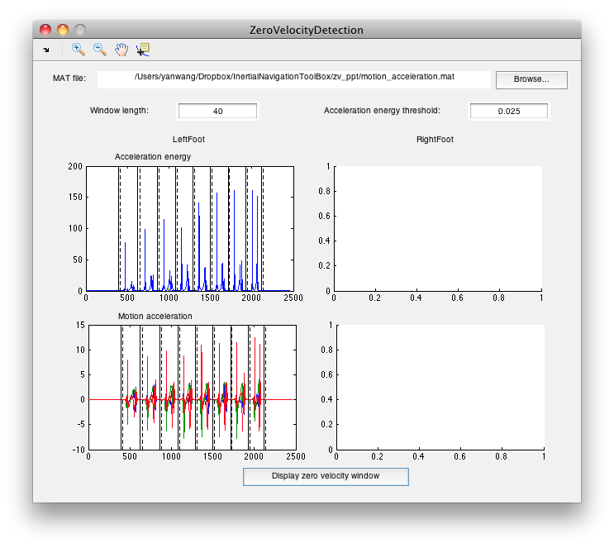
4. Zero Velocity Detection (Stance Detection)
Zero Velocity Detection: threshold the motion acceleration energy (acc variance, gyro, acc + gyro)

Slide 6
4. Zero Velocity Update - Before
Velocity will drift over time.

Slide 7
4. Zero Velocity Update - Hard
The resetting point is discontinuous.

Slide 8
4. Zero Velocity Update - Soft
Velocity Drift
Velocity Drift
Velocity Drift
Velocity Drift
The velocity drift is quite linear.

Slide 9
4. Zero Velocity Update - Soft
Subtract the velocity drift from the velocity.

Slide 10
4. Zero Velocity Update - Soft

Slide 11
5. Assignment
Create your own code to perform zero velocity update
Collect walking data with a single sensor and record manually measured walking distance
Create your own code to perform hard zero velocity update
Create your own code to perform soft zero velocity update

Slide 12
6. Reference
System Overview:
Oliver J. Woodman, An introduction to inertial navigation.
Zero Velocity Window Detection:
Isaac Skog and et al, Zero-Velocity Detection—An Algorithm Evaluation.
Zero Velocity Update:
A.R. Jimenez and et al, A Comparison of Pedestrian Dead-Reckoning Algorithms using a Low-Cost MEMS IMU.
Advance System:
Eric Foxlin, Pedestrian Tracking with Shoe-Mounted Inertial Sensors.

